Slide 1

ML Fundamentals and Intro to Python
Michigan Hackers Machine Learning Team

Slide 2
Ice Breaker
Say your name, year, major, where you’re from, and answer the following question:
If you could invite one person over for dinner -- living, dead, or fictional -- who would you invite and why?

Slide 3
Agenda
ML Overview
Installing Anaconda
Setting up terminal and git
Running your first Python program
Introducing your Python learning materials
Work and ask questions

Slide 4
ML Overview

Slide 5
What is Machine Learning?
“Machine learning (ML) is the study of computer algorithms that improve automatically through experience” (Wikipedia)
How does machine learning relate to other fields?
AI: the study of agents which use perceptions of their environment to inform their actions in the pursuit of some goal
Data Science: interdisciplinary field that uses scientific methods, algorithms, and systems to extract knowledge from data
Optimization: maximizing or minimizing a function by systematically choosing inputs
Statistics: drawing population inferences from a sample

Slide 6
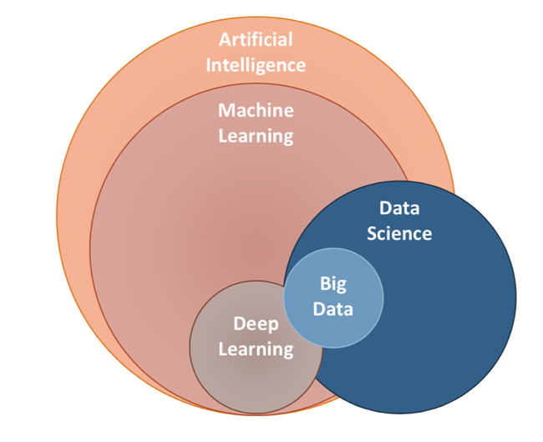
Notes:
image source: https://gmggroup.org/wp-content/uploads/2019/07/AI-Venn-diagram.png

Slide 7
ML vs Traditional Programming
Traditional
Input
Desired result
Program
What the programmer gives the computer
What the computer gives the programmer
ML
Input
Desired result
Program

Slide 8
Applications of Machine Learning
Information Retrieval and Web Search -- Google
Computational Biology and Physics -- ATLAS Experiment
Finance and Ecommerce -- Capital One
Space Exploration -- NASA
Computer Vision and Robotics -- Amazon
Social Networks -- Facebook
Autonomous Vehicles -- Tesla
Natural Language Processing -- Siri
Quantum Computing -- IBM
Many many more applications in several industries.

Slide 9







Slide 10
Types of Machine Learning Algorithms
Supervised Learning
training data and their labels are given
Unsupervised Learning
training data are given without their labels
Semi-Supervised Learning
training data are given; some are labeled
Reinforcement Learning
actions are adjusted based on rewards

Slide 11
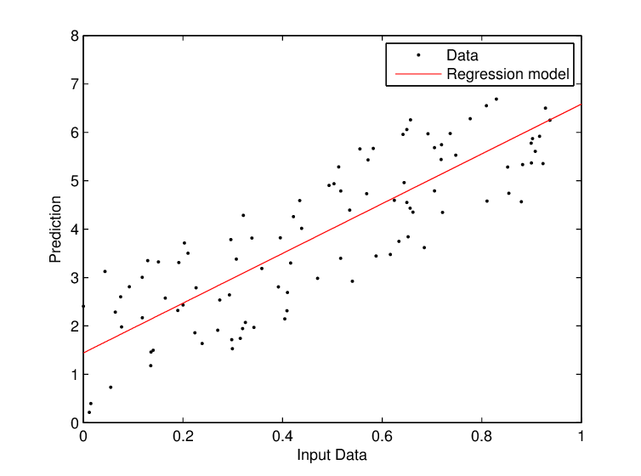
Regression Problems
Regression analysis is a part of supervised learning that estimates the relationship between two or more variables.
Given (x1, y1), (x2, y2), ..., (xn, yn)
Learn a function f(x) to predict y given x
y is real-valued -> regression

Slide 12
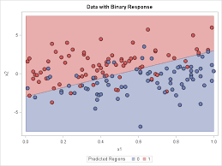
Classification Problems
Classification is a part of supervised learning that categorizes discrete data into two or more sets.
Given (x1, y1), (x2, y2), ..., (xn, yn)
Learn a function f(x) to predict y given x
y is categorical -> classification

Slide 13
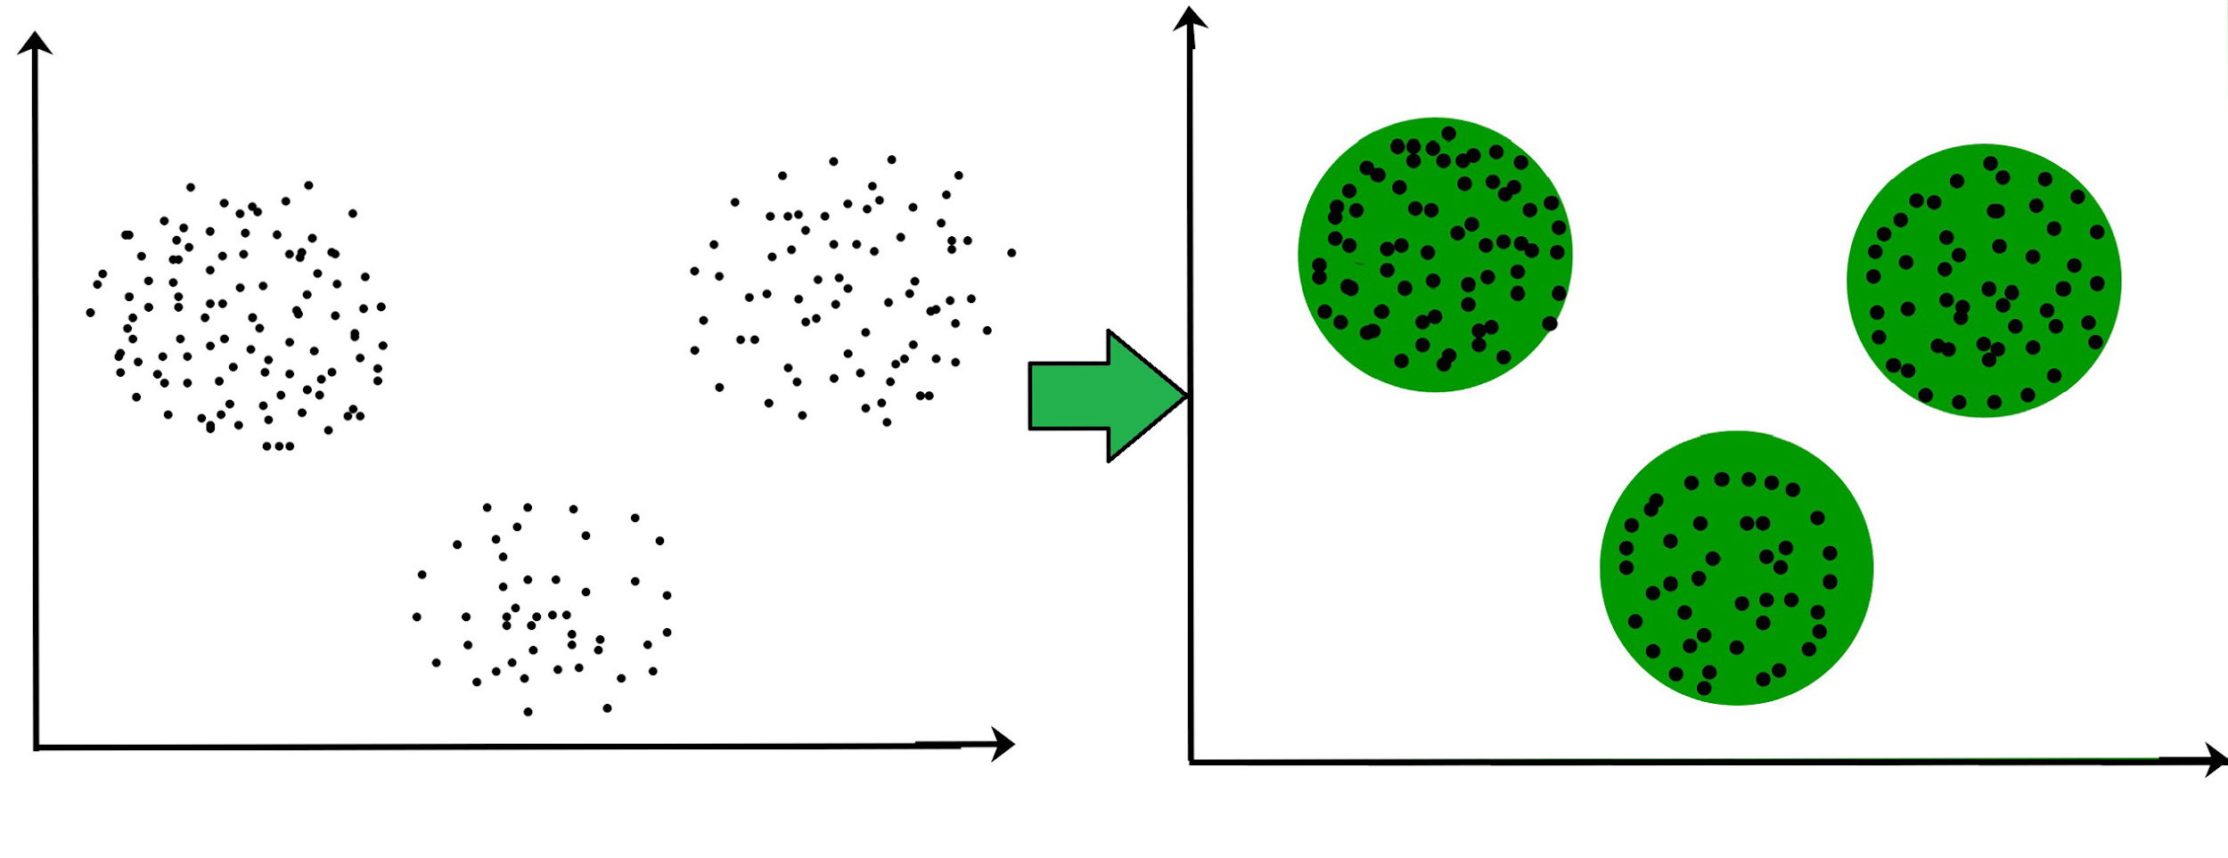
Clustering Problems
Clustering is a form of unsupervised learning that groups unlabeled data into two or more sets.
Given x1, x2, …, xn, we want to find some hidden structure behind the data
Notes:
image source: https://www.geeksforgeeks.org/clustering-in-machine-learning/

Slide 14

Reinforcement Learning

Slide 15
Installing Anaconda

Slide 16
Install Anaconda
Follow this link: https://www.anaconda.com/products/individual
Click the “Download” button
Select the graphical installer for your operating system

Slide 17
Define Terms
Programming language: a set of syntactic rules and “words”
Python: a programming language
Python implementation: a program which can interpret and run files written in the Python language
Python distribution: a bundle containing a Python implementation alongside numerous tools
Anaconda: a Python distribution

Slide 18
Define Terms
Notebook file: a special type of file containing cells which can run code or be used as plain text
Jupyter Notebook: an application which runs in your browser and can open notebook files. One of the “tools” in Anaconda.
Anaconda Navigator: an application with a graphical user interface (GUI) which makes it easy to use the rest of the Anaconda distribution. One of the “tools” in Anaconda

Slide 19
Anaconda Overview
We install Anaconda which contains a Python implementation, Anaconda Navigator, and Jupyter Notebook.
We use Anaconda Navigator to launch Jupyter Notebook where we write and run Python programs in notebook files.
The Python implementation interprets our programs behind the scenes when we click “Run” in a notebook file.

Slide 20
Setting up Terminal and Git
Follow this tutorial presentation link

Slide 21
Running Python

Slide 22
Hello World in Python
In Anaconda, launch Jupyter Notebook which will open up in your default browser.
Navigate to your MHML folder, not the machine-learning folder which uses git, on Jupyter.
On the top right corner, click the New: tab and select Python 3 Notebook. This will open a new script in a new tab.
Rename the Untitled notebook, HelloWorld.
In the first line, type in the code
print("Hello World!")
Click Run and “Hello World!” should print below the code.
Save the notebook.
Congratulations! You just wrote your first Python Script!

Slide 23
Work and Ask Questions

Slide 24
Work and Ask Questions
Resolve issues with your computer setup
Complete the updated Onboarding Document
Begin learning Python
Beginner: Courses 1-3 of the Python 3 Programming Specialization on Coursera. Use the practice feature of the interactive textbook every day
Intermediate: Review chapters 2 and 3 of Data Science from Scratch. Practice writing code in Jupyter as you go

Slide 25

Thank You!
Michigan Hackers Machine Learning Team
Contact Info:
Rajas Gupta | rajasg@umich.edu
Vijay Shamra | vsharm@umich.edu
Provide Feedback

